Slide 1
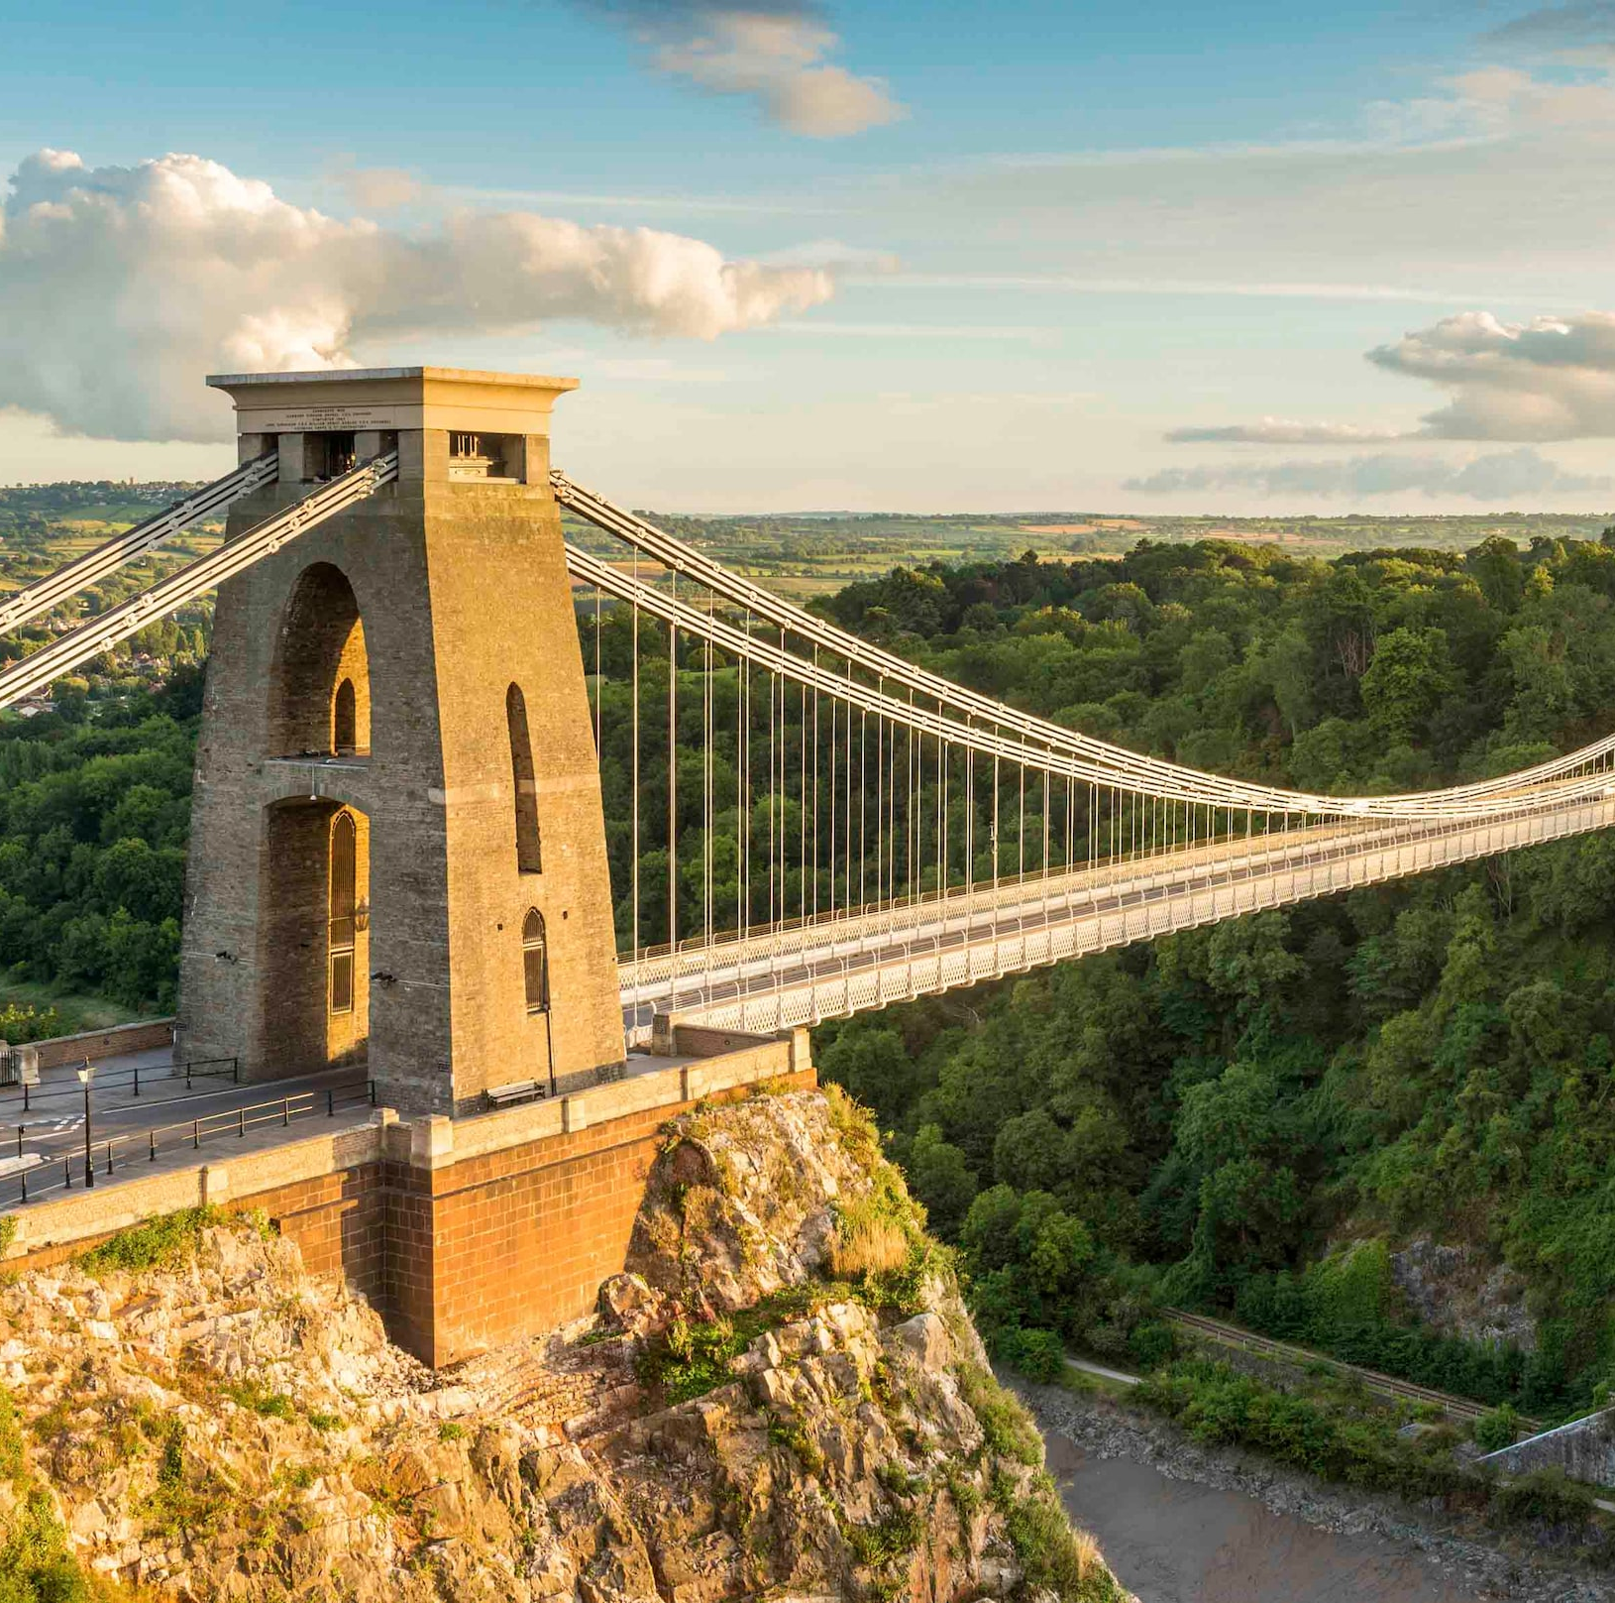
Clifton Suspension Bridge Visitor Centre
Cerys, Laura & Luke

Slide 2
Challenge Summary
The Clifton Bridge Visitor Centre is hidden away on the west wing of the bridge. With its out-of-date interactions, it lacks entertainment and engagement for tourists. In turn, there is a deficiency in strong pull factors, leading to short term visits.

Slide 3
Current Situation
Missing entertainment
Out of date interactions at visitor centre
Insufficient engagement with the younger generation (Ages 8-16)
Lack of directions and knowledge of Visitor Centre

Slide 4
What are we trying to achieve?
Increase tourism for the Visitor Centre
Educate the youth on the suspension bridge
Increase engagement with the younger generation in the form of entertainment

Slide 5
Who is this for?
The interactive project will be designed for all ages with a focus on children aged 8-16.
Visitor Centre

Slide 6
Who will this impact?
The youth will be educated and entertained by the exhibit
The Visitor Centre will gain more foot traffic potentially resulting in more funding

Slide 7
Constraints
The project will be not be limited to indoors or outdoors.
Indoors – there are separate rooms in the Visitor Centre where there is a large amount of space to put this project, mainly upstairs
Have to get tourists to go into the Visitor Centre to begin with and then get them to travel upstairs
Accessibility issue with stairs?
Outdoors – near the road, high up, weather, hard to access with no transport

Slide 8
Prototype form
Unity
Maya
Physical Models
Video
Graphics
MAX msp

Slide 9
Prototype schedule
Week 1 – Introduction to Interaction Design
Week 2 – Embodied Interactions (Fieldwork Preparation)
Week 3 – Fieldwork
Week 4 – Creating Design Brief and The Problem Space
Week 5 – Design Brief Presentation
Week 6 Onwards - TBA

